Slide 1
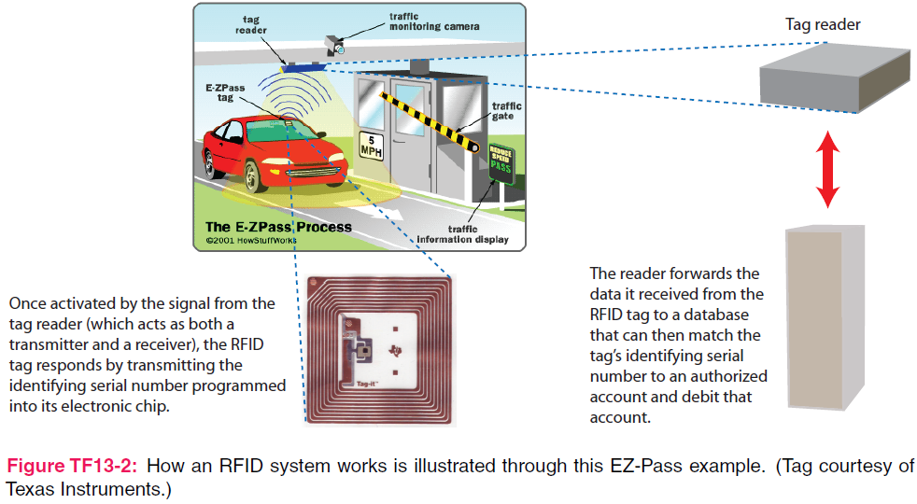
7. Plane Wave Propagation
7e Applied EM by Ulaby and Ravaioli

Slide 2
Chapter 7 Overview

Slide 3
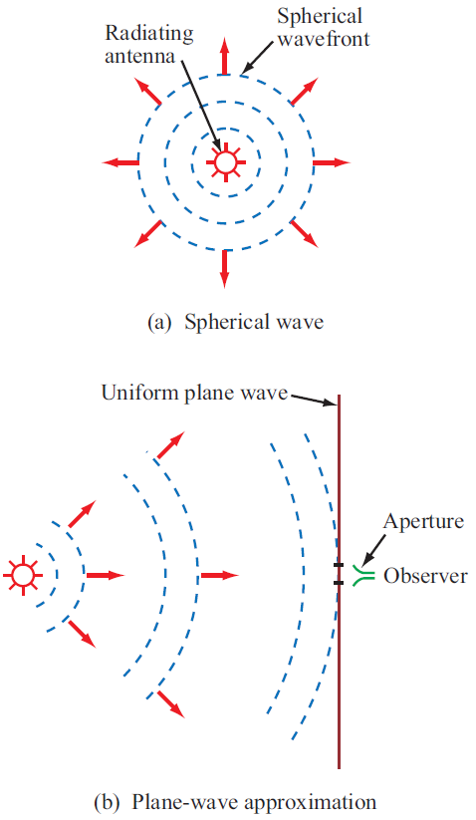
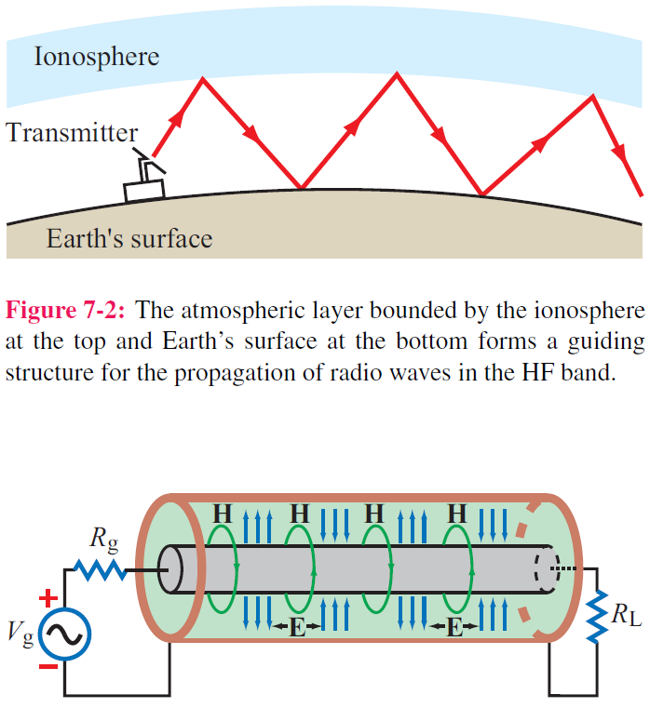
Guided EM Waves
Unbounded EM Waves

Slide 4
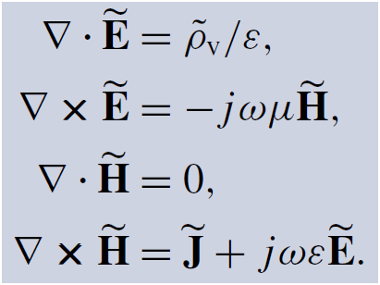
Time-Harmonic Fields
For sinusoidal time variations:
Time dependence
For a linear, isotropic, and homogeneous medium with ε and μ, the Maxwell’s equations in phasor form are

Slide 5
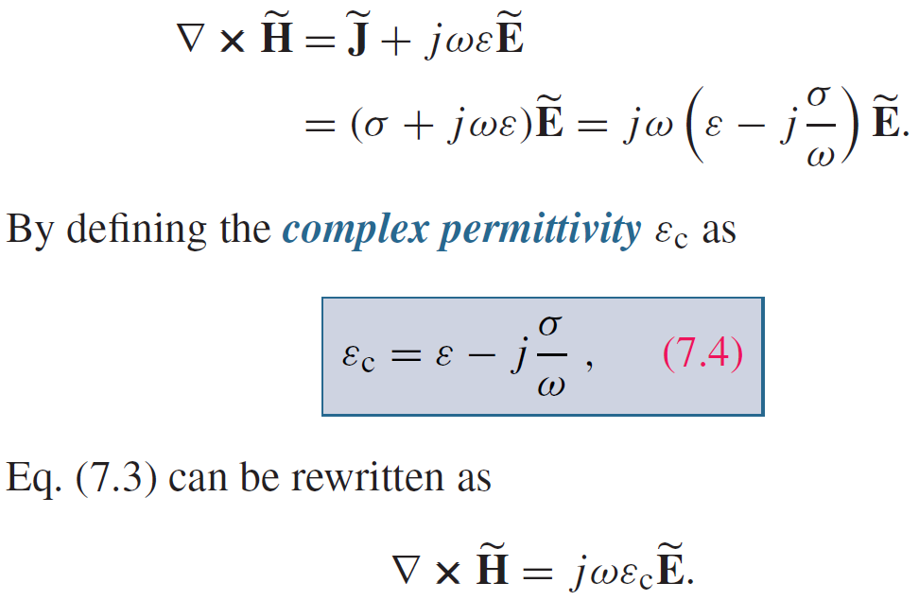
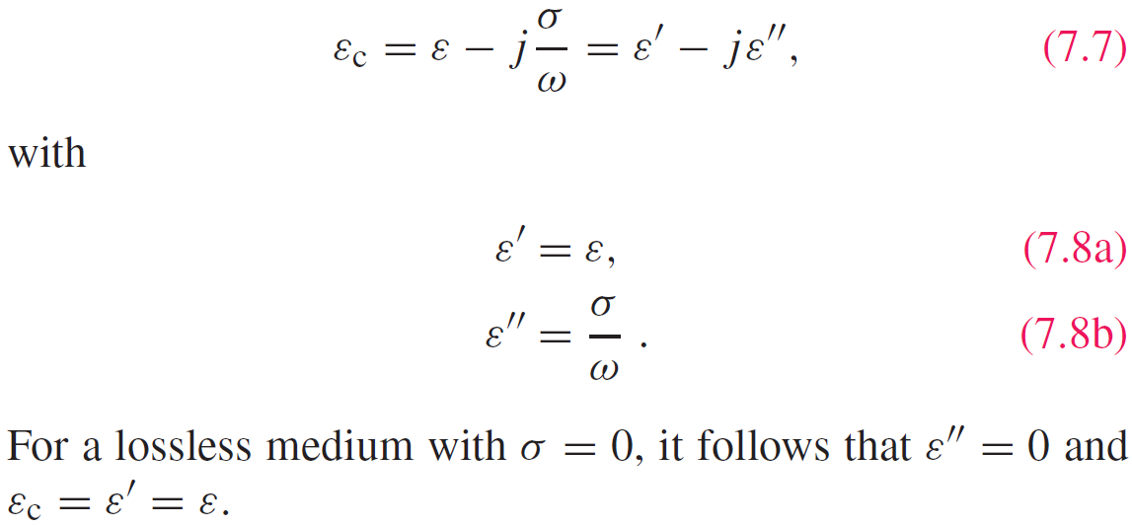
Complex Permittivity
ε” > 0 means the material is lossy

Slide 6
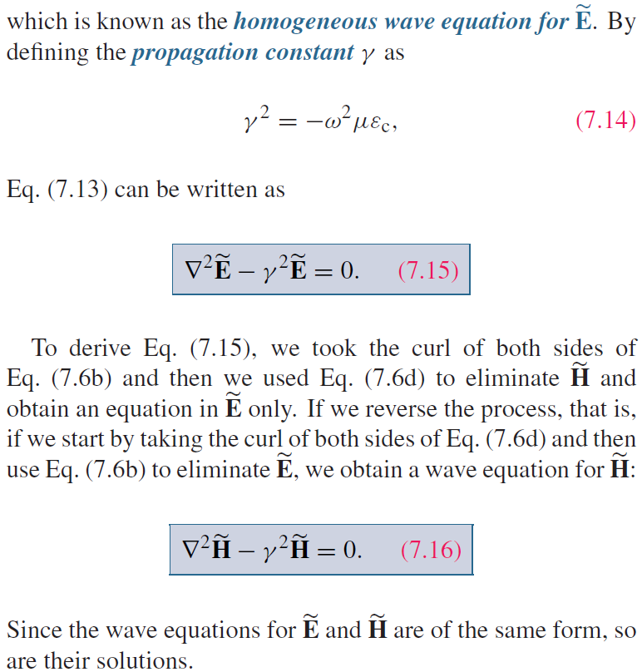
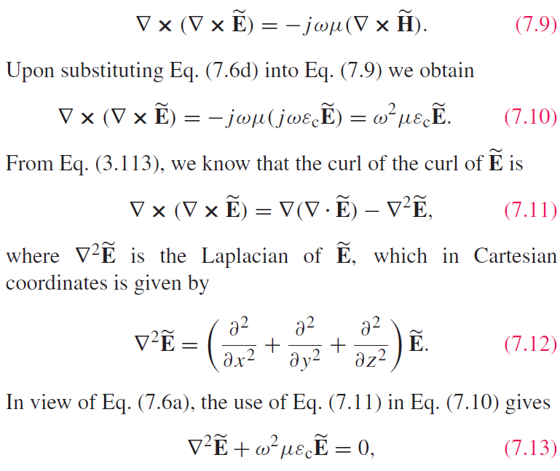
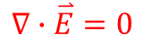
Wave Equations
Use source-free Maxwell’s equations
Helmholtz equation
$$∇∙\overset{⃑}{E}=0$$

Slide 7
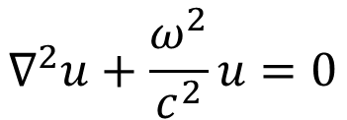
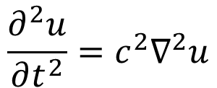
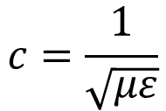
Wave Nature
Conventional wave equation
(mechanical displacement u of a wave)
$$\frac{∂^{2}u}{∂t^{2}}=c^{2}∇^{2}u$$
$$∇^{2}u+\frac{ω^{2}}{c^{2}}u=0$$
$$c=\frac{1}{\sqrt{με}}$$
Propagation Speed

Slide 8
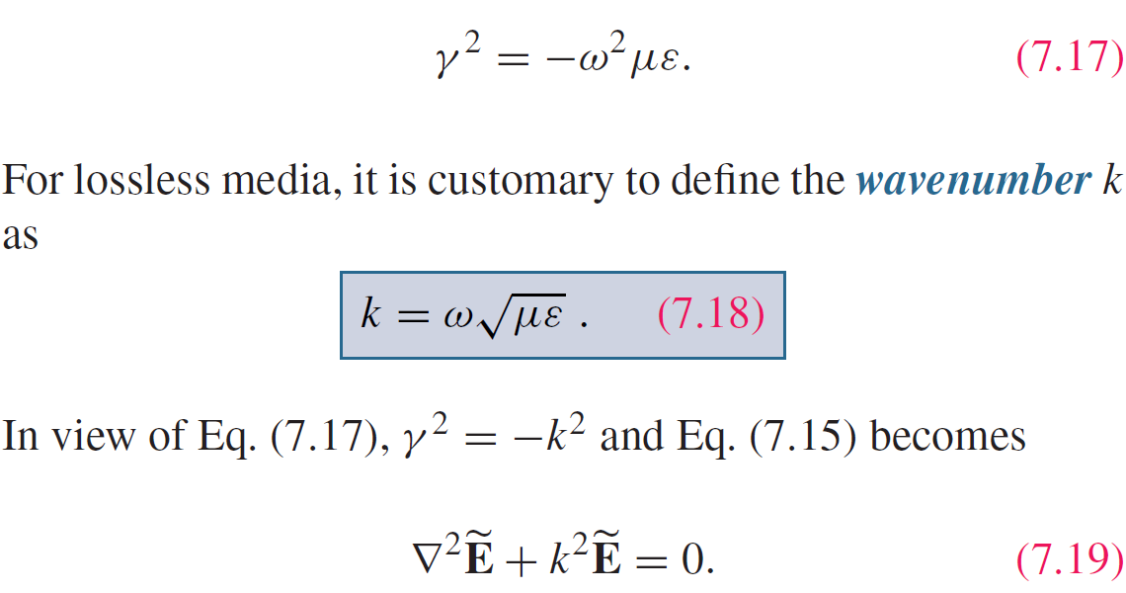
Lossless Media
If the medium is nonconducting (σ = 0), the wave does not suffer any attenuation as it travels and hence the medium is said to be lossless.
Here is positive sign

Slide 9
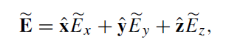
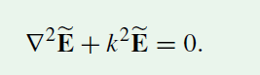
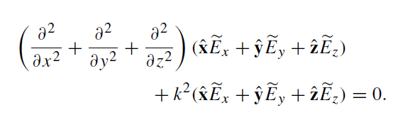
Solve the Wave Equation
Use this PDE equation to solve for E, or solve for E_{x}, E_{y} and E_{z}
This PDE equation can be expanded to

Slide 10
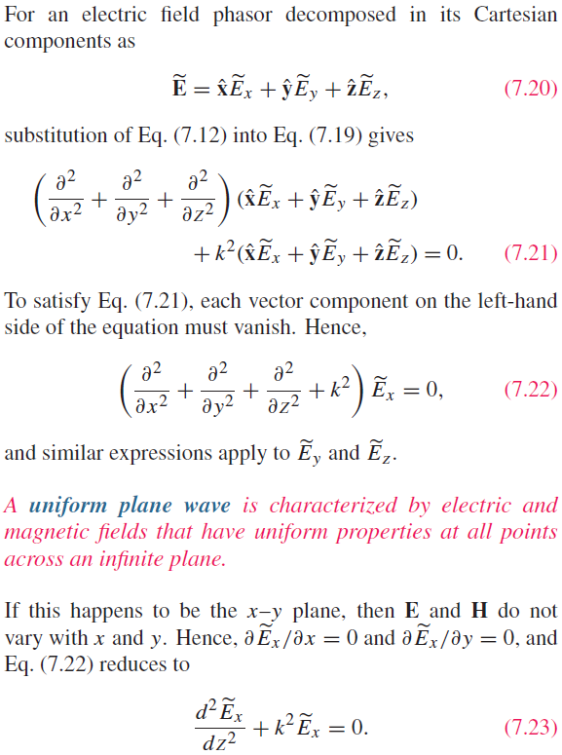
Uniform Plane Wave
Split the vector PDE equation into three scalar PDE equation
Uniform magnitude and uniform direction

Slide 11
Transverse Electromagnetic (TEM) Wave

Slide 12
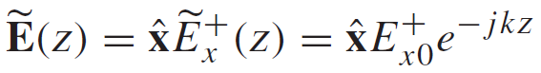
Uniform Plane Wave Solution
-z propagation
General Form of the Solution:
+z propagation
For a wave travelling along +z only:

Slide 13
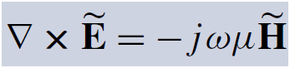
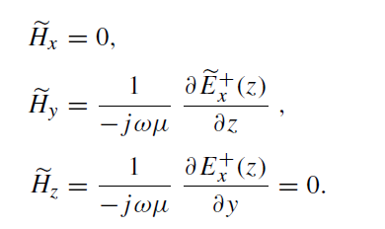
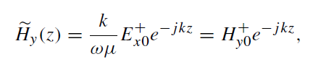
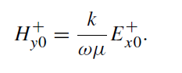
Uniform Plane Wave Solution
The corresponding M field is obtained by

Slide 14
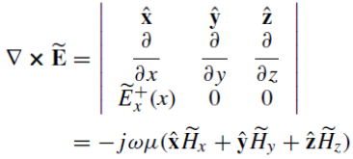
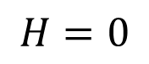
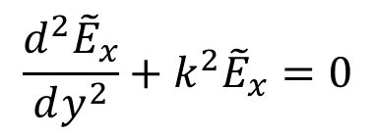
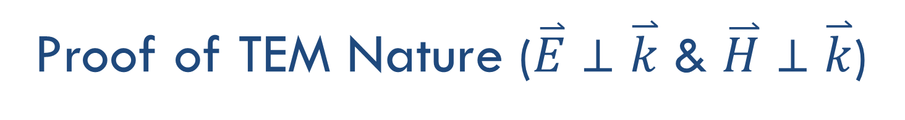
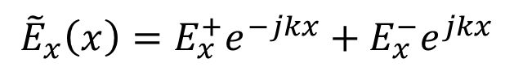
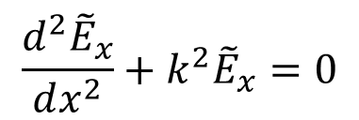
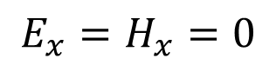
Proof of TEM Nature ($\overset{⃑}{E}⊥\overset{⃑}{k}$ & $\overset{⃑}{H}⊥\overset{⃑}{k}$)
Fields do not change with x and y
$$\frac{d^{2}{\tilde{E}}_{x}}{dy^{2}}+k^{2}{\tilde{E}}_{x}=0$$
Fields do not change with x and z
$$\frac{d^{2}{\tilde{E}}_{x}}{dx^{2}}+k^{2}{\tilde{E}}_{x}=0$$
Fields do not change with y and z
$${\tilde{E}}_{x}\left(x\right)=E_{x}^{+}e^{−jkx}+E_{x}^{−}e^{jkx}$$
$$E_{x}=H_{x}=0$$
$$H=0$$

Slide 15
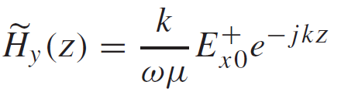
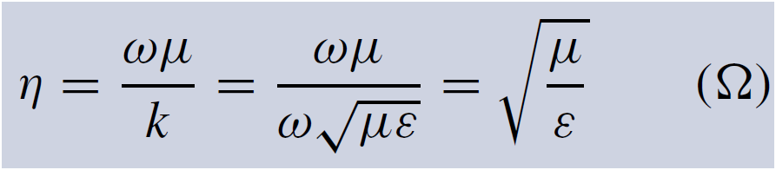
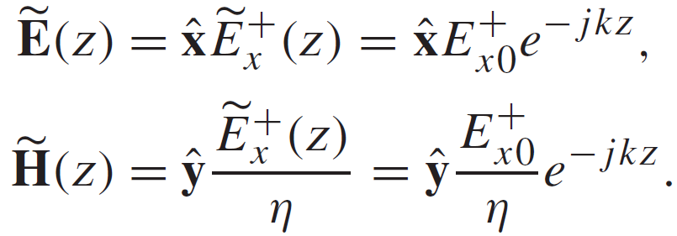
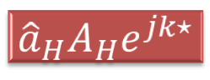
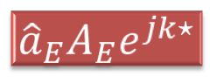
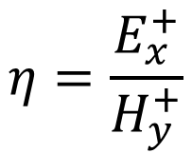
Intrinsic Impedance
$$η=\frac{E_{x}^{+}}{H_{y}^{+}}$$
Intrinsic impedance of the medium or wave impedance
Summary: This is a plane wave with
$${\hat{a}}_{E}A_{E}e^{jk⋆}$$
Exponential term for propagation
Direction
Amplitude
$${\hat{a}}_{H}A_{H}e^{jk⋆}$$

Slide 16
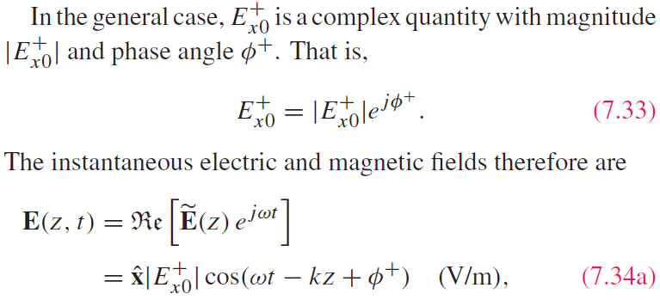
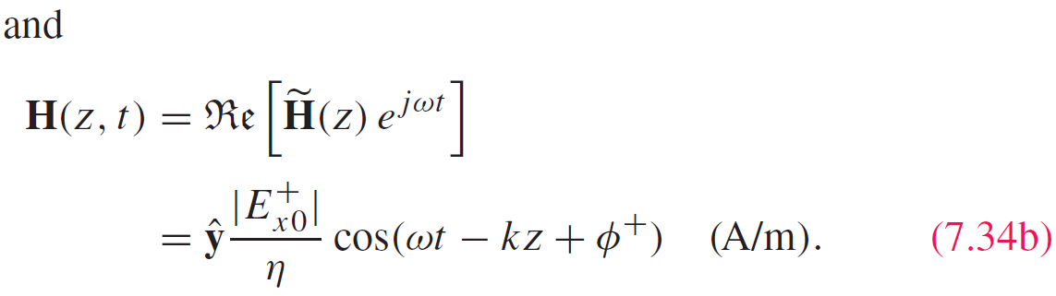
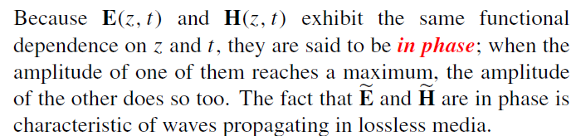
Time-Domain Solution

Slide 17
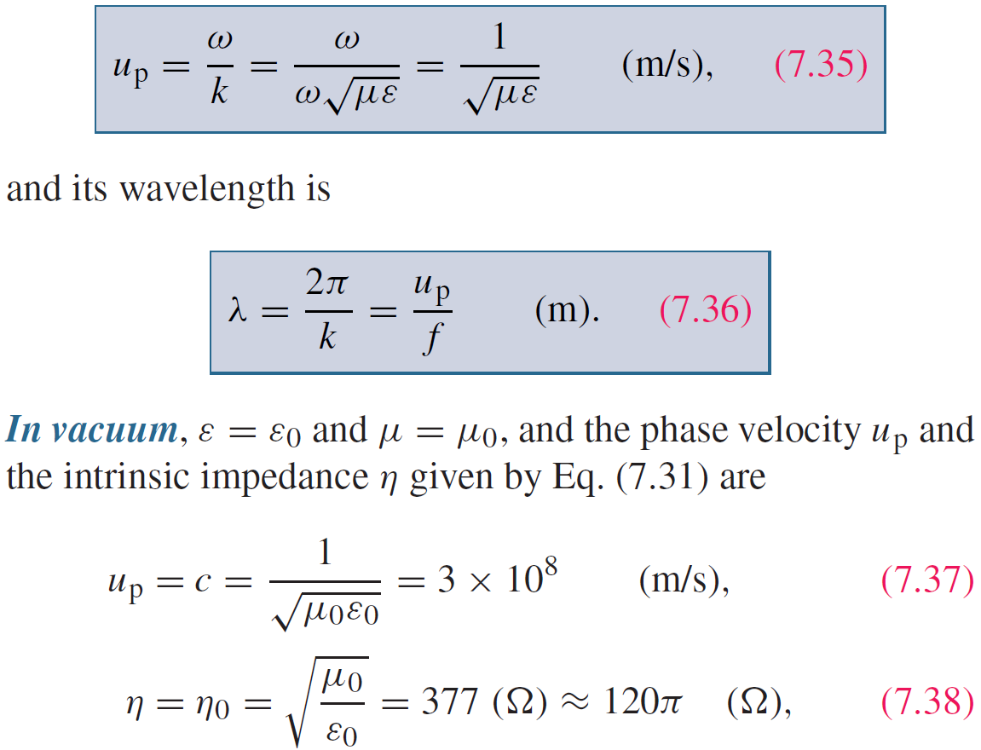
Wave’s Phase Velocity

Slide 18
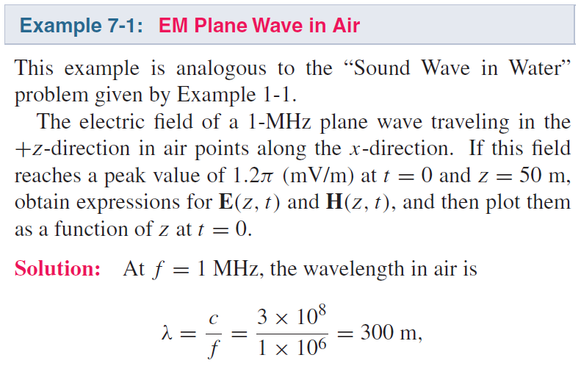
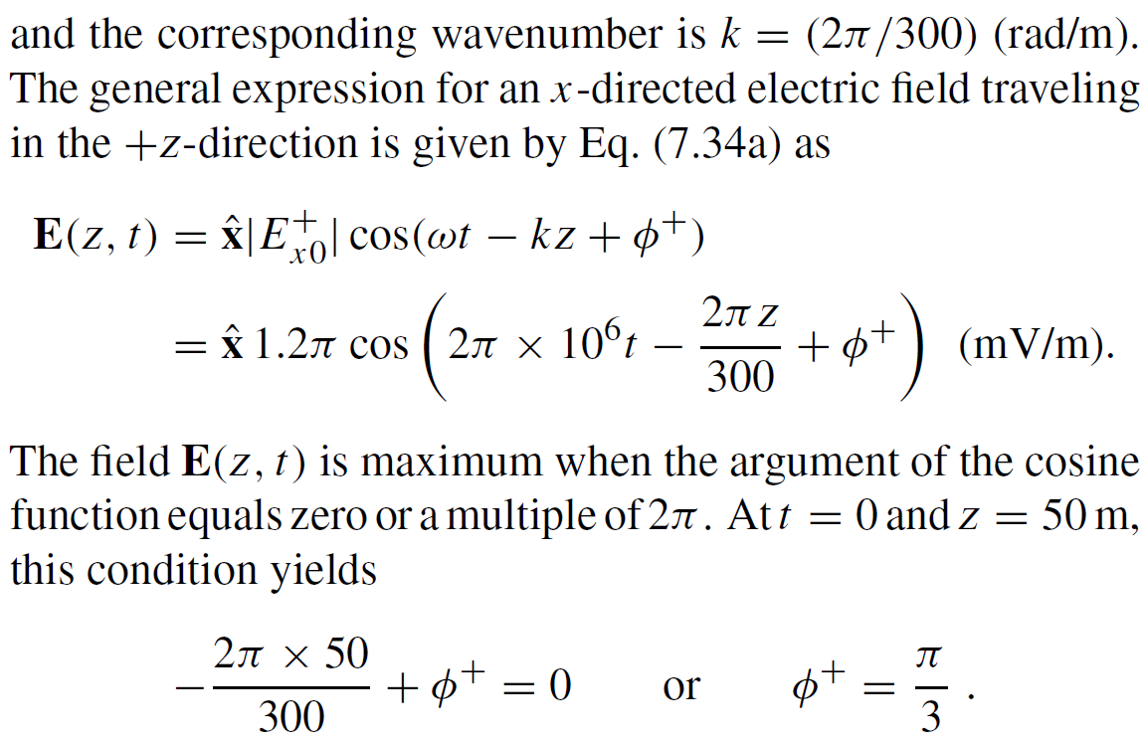
Cont.

Slide 19
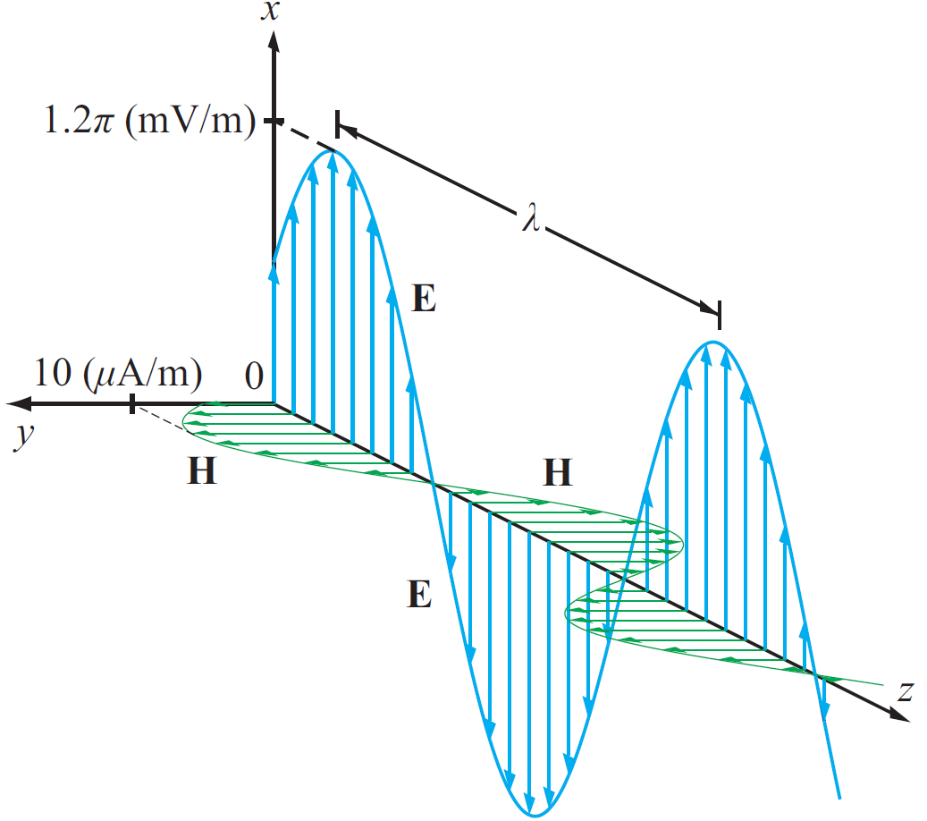
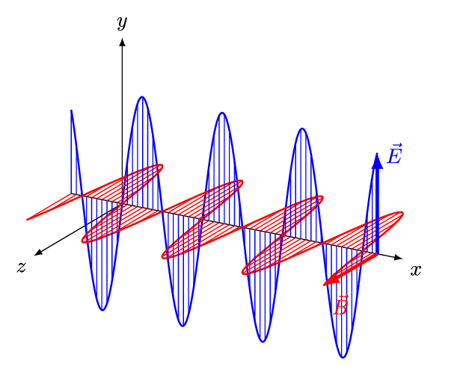
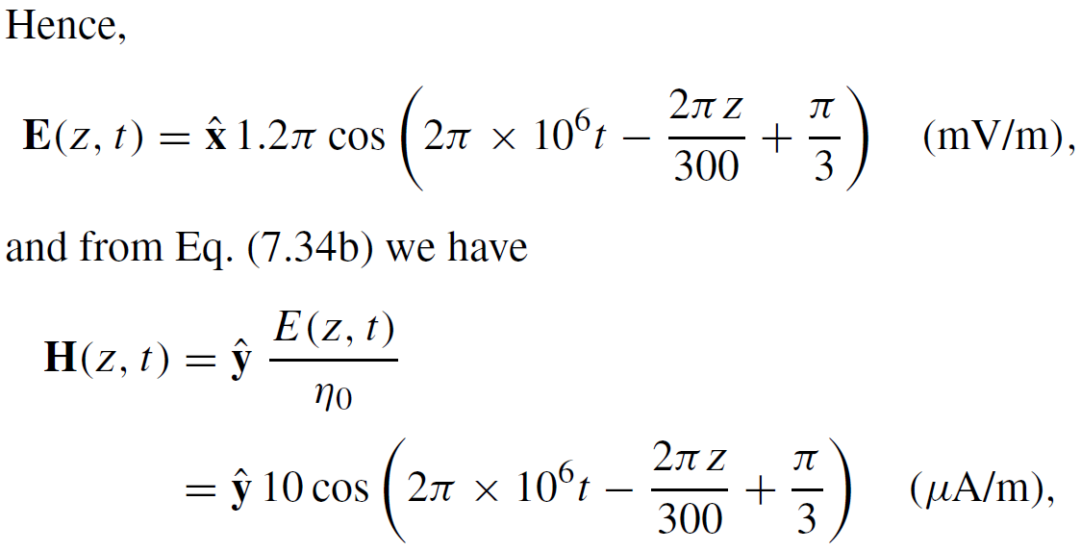
Example 7-1 cont.

Slide 20
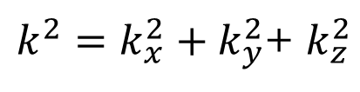
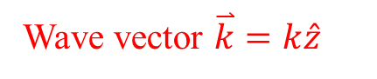
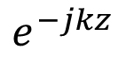
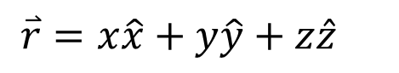
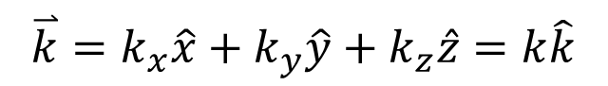
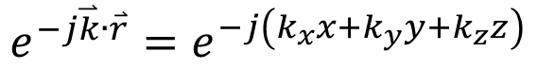

General Plane Wave
+z propagation
$$e^{−jkz}$$
${\left(\frac{1}{λ}\right)}^{2}={\left(\frac{1}{λ_{x}}\right)}^{2}+{\left(\frac{1}{λ_{y}}\right)}^{2}$+${\left(\frac{1}{λ_{z}}\right)}^{2}$
Wave vector $\overset{⃑}{k}=k\hat{z}$
General-direction propagation
$$e^{−j\overset{⃑}{k}∙\overset{⃑}{r}}=e^{−j\left(k_{x}x+k_{y}y+k_{z}z\right)}$$
$k^{2}=k_{x}^{2}+k_{y}^{2}$+ $k_{z}^{2}$
$$\overset{⃑}{k}=k_{x}\hat{x}+k_{y}\hat{y}+k_{z}\hat{z}=k\hat{k}$$
$$\overset{⃑}{r}=x\hat{x}+y\hat{y}+z\hat{z}$$
General plane wave
$$\overset{⃑}{E}={\overset{⃑}{E}}_{0}e^{−j\overset{⃑}{k}∙\overset{⃑}{r}}=\left(E0x\hat{x}+E0y\hat{y}+E0z\hat{z}\right)e^{−j\overset{⃑}{k}∙\overset{⃑}{r}}$$

Slide 21



Cont.
$$\hat{e}×\hat{h}=\hat{k}$$
For Any TEM Wave
$\hat{k}$ is the unit vector in the direction of propagation (not wave vector)

Slide 22


Wave decomposition

Slide 23


Example
An infinite sheet of alternating surface current can be considered as a source for plane waves. If an electric surface current density ${\overline{J}}_{s}=J_{0}\hat{x}$ exists on the z = 0 plane in free-space, find the resulting fields by assuming plane waves on either side of the current sheet and enforcing boundary conditions.
x
Since the entire surface current have uniform phase, it can be determined that the generated plane waves also have planar wavefronts in xy planes
Then the plane wave propagates in +z and –z direction
E must be in –x direction
H must be in –y direction for z propagation, and +y direction for –z propagation
$${\overline{J}}_{s}$$
z
y

Slide 24
Cont.
Then the fields can be written in the following form with A and B are arbitrary numbers representing field amplitudes in the z < 0 and z > 0 region
The boundary conditions at z = 0 are
So, we can get

Slide 25





Wave Polarization
Phase difference
If:
Plane wave propagating along +z :
then
$$a_{x}≥0 a_{y}≥0$$
Generally complex numbers

Slide 26


Polarization State
Polarization state describes the trace of E as a function of time
at a fixed z
Magnitude （not amplitude） of E
Inclination Angle

Slide 27




Linear Polarization:
or
E traces a line( in blue) as the wave traverses a fixed plane
Special cases

Slide 28




Circular Polarization
Polarization Handedness
Left-hand
Right-hand

Slide 29


LH Circular Polarization:
y component is 90° ahead of x component
phase of x component needs to take T/4 to become the current phase of y component
Constant magnitude

Slide 30

RH Circular Polarization:
x component is 90° ahead of y component

Slide 31



Cont.

Slide 32
Example 7-2 cont.
Wave with electric field magnitude
of 3 (mV/m) traveling in the +y-direction
Cont.

Slide 33
Example 7-2 cont.

Slide 34




Elliptical Polarization: General Case
Linear and circular polarizations are special cases of elliptical polarization

Slide 35

Cont.

Slide 36


Example 7-3 cont.

Slide 37


Lossy Media
Lossless
Definition
Cont.

Slide 38

Lossy Media
Both are positive
Check when ε” = 0

Slide 39

Attenuation
E and H fields:
Direction
Amplitude
Attenuation
Propagation
+z propagation
Cont.

Slide 40



Attenuation
Magnitude of E
$$power∝e^{−2αz}$$
Skin depth

Slide 41

Low and High Frequency Approximations

Slide 42

Example 7-4: Plane Wave in Seawater
Cont.

Slide 43

Example 7-4: Plane Wave in Seawater
Cont.

Slide 44
Example 7-4: Plane Wave in Seawater
Cont.

Slide 45
Example 7-4: Plane Wave in Seawater
Cont.

Slide 46
Example 7-4: Plane Wave in Seawater

Slide 48




Power Density
Poynting vector:
Total power intercepted by A:
Time-average power density:

Slide 49



Plane Wave in Lossless Medium
For a plane wave with E H field :
Generally complex numbers
The time-average power density carried by the wave is:

Slide 50






Plane Wave in Lossy Medium
For a plane wave travelling in a lossy medium:
If $\overset{⃑}{E}×{\overset{⃑}{H}}^{∗}$ is complex, only the real part represents the real power that can flow with the wave propagation
the power density is :

Slide 51




Slide 52






Power Density of Different Polarization
$$\overset{⃑}{H}=\hat{y}\frac{E_{0}}{η_{0}}e^{−jkz}$$
Linear Polarization
$$\overset{⃑}{E}=\hat{x}E_{0}e^{−jkz}$$
$${\overset{⃑}{S}}_{av}=\frac{1}{2}Re\left[\overset{⃑}{E}×{\overset{⃑}{H}}^{∗}\right]=\hat{z}\frac{{\left|E_{0}\right|}^{2}}{2η_{0}}$$
Circular Polarization
$$\overset{⃑}{H}=\frac{E_{0}}{η_{0}}\left(\hat{y}−j\hat{x}\right)e^{−jkz}$$
$$\overset{⃑}{E}=E_{0}\left(\hat{x}+j\hat{y}\right)e^{−jkz}$$
$${\overset{⃑}{S}}_{av}=\frac{1}{2}Re\left[\overset{⃑}{E}×{\overset{⃑}{H}}^{∗}\right]=\frac{E_{0}^{2}}{2η_{0}}Re\left[\left(\hat{x}+j\hat{y}\right)e^{−jkz}×\left(\hat{y}+j\hat{x}\right)e^{jkz}\right]$$
$$=\frac{E_{0}^{2}}{2η_{0}}Re\left[\left(\hat{x}+j\hat{y}\right)×\left(\hat{y}+j\hat{x}\right)\right]=\frac{E_{0}^{2}}{2η_{0}}Re\left[\hat{z}+\hat{z}\right]=\hat{z}\frac{{\left|E_{0}\right|}^{2}}{η_{0}}$$
Total fields

Slide 53

Summary
Homework due XXX

